Slide 1
Project Presentation On Electricity Bill Management System
Laila Arjumand Zannat
Roll:1909008
Dept: Electronics and Communication Engineering

Slide 2
Project: Electricity Bill Management System
Electricity Bill Management System deals with the management of Electricity Bills and customer details in the library.
It facilitates the system of bill collection and storing information.
The database for electricity billing system is organized into 6 tables.
The tables are Customer, Account, Electricity_Bill, Elec_board, Tariff and Invoice.

Slide 3
Meter_number
Amount
Per_unit
Eboard_id
Board_name
Cust_id
Acc_id
1
Cust_name
Electricity_Bill
Elec_board
Occupation
Cust_id
M
Monthly_unit
Customer
Contains Detail on
Meter_number
1
Consists data which are required for
Address
City
Invoice_id
Eboard_id
Has
1
Genetares
Invoice
1
Tariff_id
1
Acc_id
Reading_date
Account_no
Name
M
1
Cust_id
Account
Calculated in
Account_no
1
M
Tariff_type
Tariff
Tarif_id

Slide 4
Schema Diagram
Customer
Cust_id number (10) (p.k.) Cust_name varchar (20) Address varchar (15) City varchar (10) Occupation varchar (15)
Invoice
Invoice_id number (05) (p.k.) Account_no number (10) meter_number number (10) (f.k.) Reading_date date(yyyy-mm-dd) Eboard_id number(05) (f.k.) Tariff_id number(05) (f.k.)
Tariff
Tariff_id number (05) (p.k.) Tariff_type varchar(50)
Electricity_Bill
Meter_number number (10) (p.k.) Acc_id number (05) (f.k.) Cust_id number (10) (f.k.) Monthly_unit float(10) Per_unit float (10) Amount float (10)
Elec_board
Eboard_id number (05) (p.k.) Board_name varchar(50)
Account
Acc_id number (05) (p.k.) Cust_id number (10) (f.k.) Account_no number (10) Name varchar (20)

Slide 5
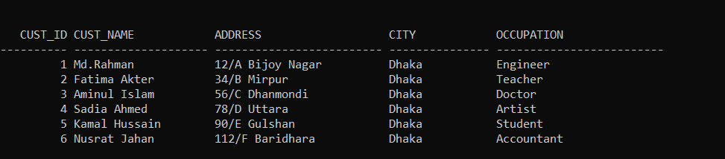
Table for Customer

Slide 6
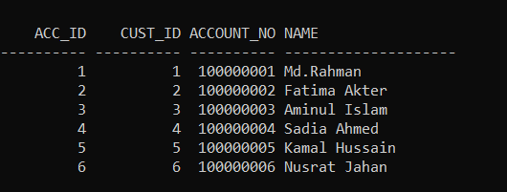
Account Table

Slide 7
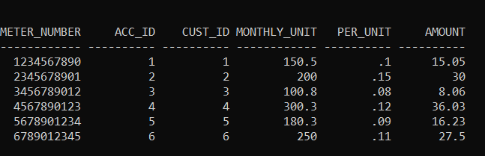
Electricity Bill Table

Slide 8
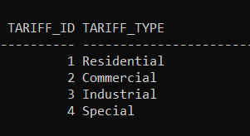
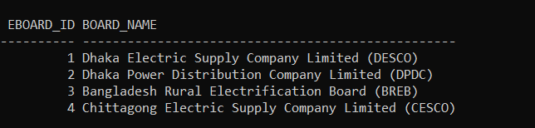
Tariff and Electricity Board Table

Slide 9
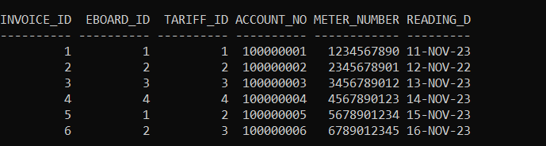
Invoice Table

